Slide 1

Play static
Prepared by :melad naeem henawy
Section:2
Under supervision : Dr. Khaled Hussien

Slide 2

Play static
Shows how to use OpenAL to load audio data into an AL Buffer and play it using an OpenAL Source.

Slide 3
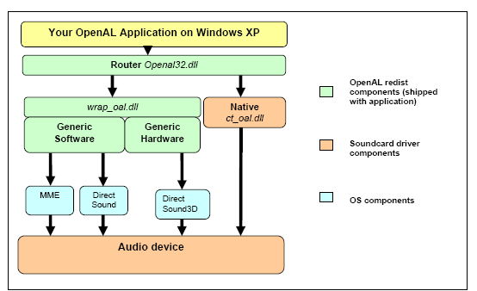
OpenAL on Windows XP

Slide 4
OpenAL on Windows XP
The diagram above shows how OpenAL is structured on a Windows XP system.

Slide 5
Generic Hardware
Although most high-performance 3D audio hardware today supports OpenAL natively, there is still a legacy of hardware which is only capable of rendering 3D audio using the DirectSound3D API on Windows XP . Fortunately it is possible to translate OpenAL calls into DirectSound3D with only a small reduction in performance and quality.

Slide 6
Generic Hardware
To allow the end user to benefit from such hardware, Creative maintains the “Generic Hardware” device. This implementation is also sometimes known as the “wrapper” or “DirectSound3D Wrapper device.

Slide 7
Generic Software
Not all users own a 3D audio accelerator card. But Windows application developers require solutions that work on every PC. So Creative maintains a fallback implementation of OpenAL that works everywhere - the Generic Software device.

Slide 8
Generic Software
This device features basic but high-quality OpenAL functionality, rendered using the host CPU. The Generic Software device is also known as the “Software Renderer” or “Software Mixer” device. If the user’s system supports DirectSound, then the Software renderer will output into a DirectSound buffer. If not, the renderer outputs to Windows Multimedia services wave output (also known as mmsystem).

Slide 9
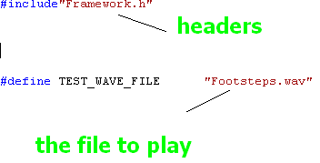
Headers files

Slide 10
Initialize Framework function
first function:-
ALFWInit();
Used to Initialize Framework

Slide 11
Initialize Framework function
void ALFWInit()
{
g_pWaveLoader = new CWaves();
}

Slide 12
Initialize Framework
if (!ALFWInitOpenAL())
{
ALFWprintf("Failed to initialize OpenAL\n"
ALFWShutdown();
return 0;
}

Slide 13
Initialize Framework of the openal
For OpenAL, initialization
normally consists of creating a context, creating the initial set of buffers, loading the
buffers with sample data, creating sources, attaching buffers to sources, setting locations
and directions for the listener and sources, and setting the initial values for state global to
OpenAL.

Slide 14
Initialize Framework of the openal
//Initialize Open AL
device = alcOpenDevice(NULL); // open default device
if (device != NULL) {
context=alcCreateContext(device,NULL); // create context
if (context != NULL) {
alcMakeContextCurrent(context); // set active context
}
}

Slide 15
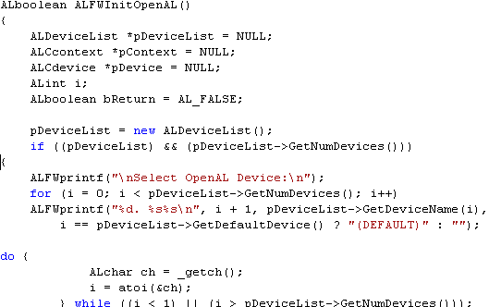
Initialize Framework of the openal

Slide 16
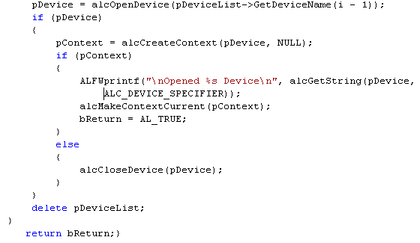
Initialize Framework of the openal

Slide 17
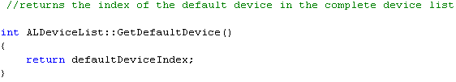
Initialize Framework of the openal

Slide 18
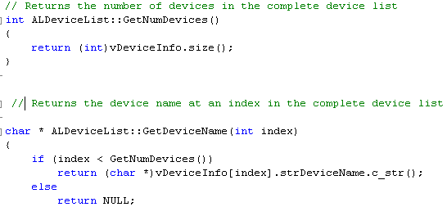
Initialize Framework of the openal

Slide 19

Generate an AL Buffer function
alGenBuffers( 1, &uiBuffer );
void alGenBuffers (ALsizei n, ALuint *bufferNames);

Slide 20
Generate an AL Buffer function
alGenBuffers(NUM_BUFFERS, g_Buffers);
if ((error = alGetError()) != AL_NO_ERROR)
{
DisplayALError("alGenBuffers :", error);
return; }

Slide 21
Generate an AL Buffer function
n:- the number of buffers to be generated
buffers :-pointer to an array of ALuint values which will store the names of the new buffers

Slide 22
Generate an AL Buffer function
This can be called at any time and multiple calls will generate multiple sets of buffers.

Slide 23
Load Wave file into OpenAL Buffer function
ALboolean ALFWLoadWaveToBuffer(const char *szWaveFile, ALuint uiBufferID, ALenum eXRAMBufferMode)

Slide 24
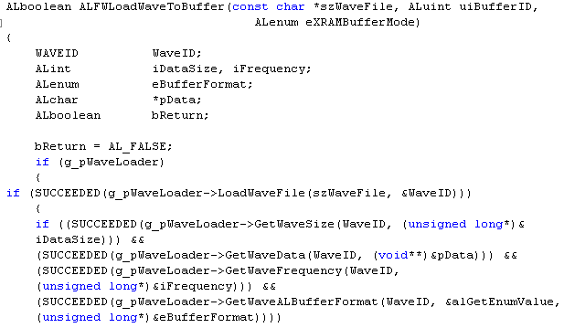
Load Wave file into OpenAL Buffer function

Slide 25
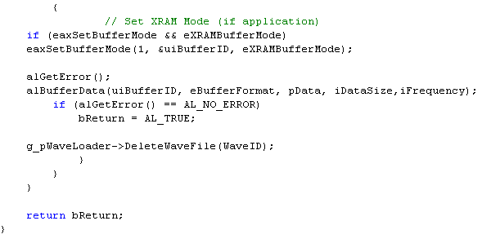
Load Wave file into OpenAL Buffer function

Slide 26
Generate a Source to playback the Buffer
alGenSources( 1, &uiSource );
void alGenSources( ALsizei n, ALuint *source);

Slide 27
Generate a Source to playback the Buffer
n:- the number of sources to be generated
Sources:- pointer to an array of ALuint values which will store the names of the new

Slide 28
Generate a Source to playback the Buffer
alGenSources(1,source);
if ((error = alGetError()) != AL_NO_ERROR)
}
DisplayALError("alGenSources 1 : ",error);
return;
}

Slide 29
Attach Source to Buffer
void alSourcei( ALuint source,ALenum
param,
ALint value
);
source :-source name whose attribute
is being set

Slide 30
Attach Source to Buffer
Param:- the name of the attribute to set
value :-the value to set the attribute to

Slide 31
Attach Source to Buffer
alSourcei(source[0], AL_BUFFER, g_Buffers[0]);
if ((error = alGetError()) != AL_NO_ERROR)
}
DisplayALError("alSourcei AL_BUFFER
0 : ", error);
{

Slide 32
Play Source function
alSourcePlay( uiSource );
void alSourcePlay( ALuint source );
Source:- the name of the source to be played

Slide 33
Get Source State function
This function retrieves an integer property of a source.
void alGetSourcei(ALuint source, ALenum pname,
ALint *value );
Source:- source name whose attribute is being retrieved

Slide 34
Get Source State function
Pname:- the name of the attribute to retrieve
value:- a pointer to the integer value being retrieved

Slide 35
Clean up by deleting Source(s) and Buffer(s)
This function stops a source.
void alSourceStop( ALuint source );
Source:- the name of the source to be stopped

Slide 36
Clean up by deleting Source(s) and Buffer(s)
This function deletes one or more sources.
void alDeleteSources(ALsizei n,
ALuint *sources );
n :-the number of sources to be deleted
Sources:- pointer to an array of source names identifying the sources to be deleted

Slide 37
Clean up by deleting Source(s) and Buffer(s)
This function deletes one or more buffers, freeing the resources used by the buffer.
void alDeleteBuffers(ALsizei n,
ALuint *buffers);
n:- the number of buffers to be deleted
Buffers:- pointer to an array of buffer names identifying the buffers to be deleted

Slide 38
Shut down openAL function
ALboolean ALFWShutdownOpenAL()
}
ALCcontext *pContext;
ALCdevice *pDevice;
pContext = alcGetCurrentContext();
pDevice = alcGetContextsDevice(pContext);
alcMakeContextCurrent(NULL);
alcDestroyContext(pContext);
alcCloseDevice(pDevice);
return AL_TRUE;
{

Slide 39
Framework shut down
void ALFWShutdown()
}
if (g_pWaveLoader)
}
delete g_pWaveLoader;
g_pWaveLoader = NULL;
}
ALFWprintf("\nPress a key to quit\n")
} ALchar ch = _getch();

Slide 40
Print function
void ALFWprintf( const char* x, ... )
}
va_list args;
va_start( args, x );
vprintf( x, args );
va_end( args );
{

Slide 41
alcGetError function
This function retrieves the current context error state.
ALCenum alcGetError( ALCdevice *device );
device :-a pointer to the device to retrieve the error state from

Slide 42
support
OpenAL 1.1 Specification.pdf book
Effects Extension Guide.pdf book
OpenAL Programmer's Guide.pdf book
OpenAL Deployment Guide.pdf book

Slide 43
Thank you

